Slide 1





CO₂ Emission Estimation Using Machine Learning
Presented by,
Giri V

Slide 2

Learning Objectives :
To understand how energy consumption parameters influence CO₂ emissions.
To learn how to collect, clean, and preprocess real-world environmental datasets.
To apply machine learning techniques—specifically Linear Regression—for prediction tasks.
To evaluate model accuracy using metrics such as R² Score and MAE.
To gain practical experience in deploying a trained ML model using Flask.
To develop a functional, user-friendly web interface for emission prediction.
GOAL
Goal of the Project :
To build an accurate system that predicts CO₂ emissions based on energy usage.
To simplify and automate emission estimation, reducing manual calculation efforts.
To create an accessible web-based tool for students, industries, and policymakers.
To support environmental monitoring and decision-making using data-driven insights.

Slide 3

Tools :
Python – Core programming language used for data processing and model development.
Jupyter Notebook / VS Code – Environment used for coding, testing, and visualization.
Pickle – Used to save and load the trained machine learning model.
Git/GitHub (if needed) – For version control and project management.
Technologies :
Machine Learning (Linear Regression Algorithm) – Used to predict CO₂ emissions based on input parameters.
Pandas & NumPy – For data cleaning, manipulation, and numerical computations.
Matplotlib – For plotting graphs and visualizing dataset patterns.
Flask Framework – To deploy the ML model and build a web-based prediction system.
HTML & CSS – Used for designing the user interface of the web application.

Slide 4
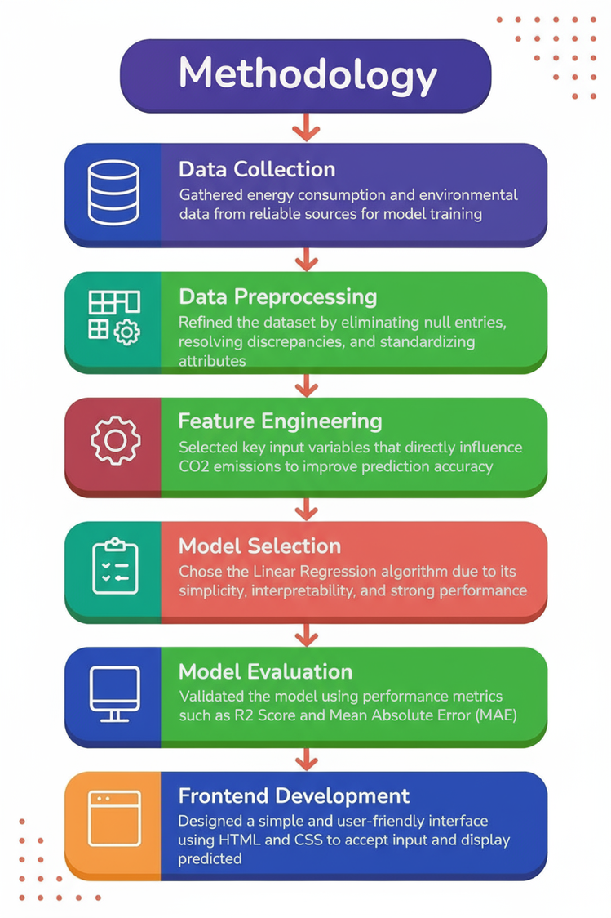
Methodology :
Data Collection: Gathered energy consumption and environmental data from reliable sources for model training.
Data Preprocessing: Cleaned the dataset by removing missing values, handling inconsistencies, and formatting numerical features.
Feature Engineering: Selected key input variables that directly influence CO₂ emissions to improve prediction accuracy.
Model Selection: Chose the Linear Regression algorithm due to its simplicity, interpretability, and strong performance on continuous data.
Model Training: Split the dataset into training and testing sets, then trained the regression model on the training portion.
Model Evaluation: Validated the model using performance metrics such as R² Score and Mean Absolute Error (MAE).
Model Deployment: Saved the trained model using Pickle and integrated it into a Flask backend for live predictions.
Frontend Development: Designed a simple and user-friendly interface using HTML and CSS to accept input and display predicted CO₂ emissions.

Slide 5

Problem Statement :
Estimating CO₂ emissions accurately has become increasingly important as industries, organizations, and governments work toward reducing their environmental impact. However, the process of calculating emissions is often complex because it depends on multiple energy-related parameters such as fuel consumption, electricity usage, and operational efficiency. Traditional methods used for estimation are mostly manual, time-consuming, and prone to human error, making them unreliable for consistent monitoring.
In many cases, users lack access to simple and automated tools that can quickly analyze energy data and generate accurate predictions. This limitation makes it difficult for both individuals and institutions to understand their environmental footprint and make informed decisions to reduce emissions. Without a reliable and accessible predictive system, monitoring CO₂ levels becomes challenging, and planning effective sustainability strategies becomes delayed and inefficient.
Therefore, there is a need for a streamlined, user-friendly, and automated solution that can accurately estimate CO₂ emissions using machine learning techniques. Such a system would help users analyze data more efficiently, identify emission trends, and ultimately contribute to global efforts toward environmental sustainability.

Slide 6

Solution :
To address the challenges in accurately estimating CO₂ emissions, this project introduces an automated, machine-learning–based prediction system designed to simplify and enhance the entire estimation process. The proposed solution uses a Linear Regression model trained on relevant energy consumption data to generate reliable emission predictions. By integrating data analytics with an easy-to-use interface, the system eliminates the need for manual calculations and reduces the chances of human error.
The application is built with a Flask backend, enabling smooth interaction between the user interface, the trained ML model, and the prediction logic. Users can input essential energy parameters directly into the system, and the model processes the data instantly to provide accurate CO₂ emission estimates. This automated workflow ensures faster analysis, better accuracy, and improved accessibility for users with varying levels of technical expertise.
Additionally, the system offers a clean, modern dashboard for visualization, making it easier to interpret results and understand emission patterns. By combining machine learning, a lightweight web framework, and a user-friendly design, the solution serves as a reliable tool for monitoring emissions and supporting environmentally responsible decision-making.

Slide 7
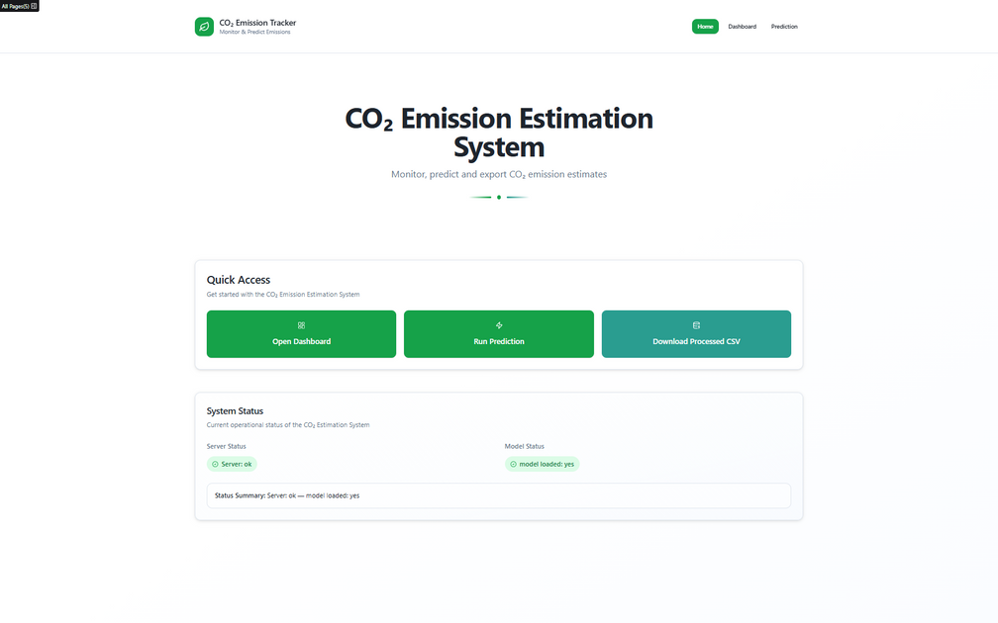
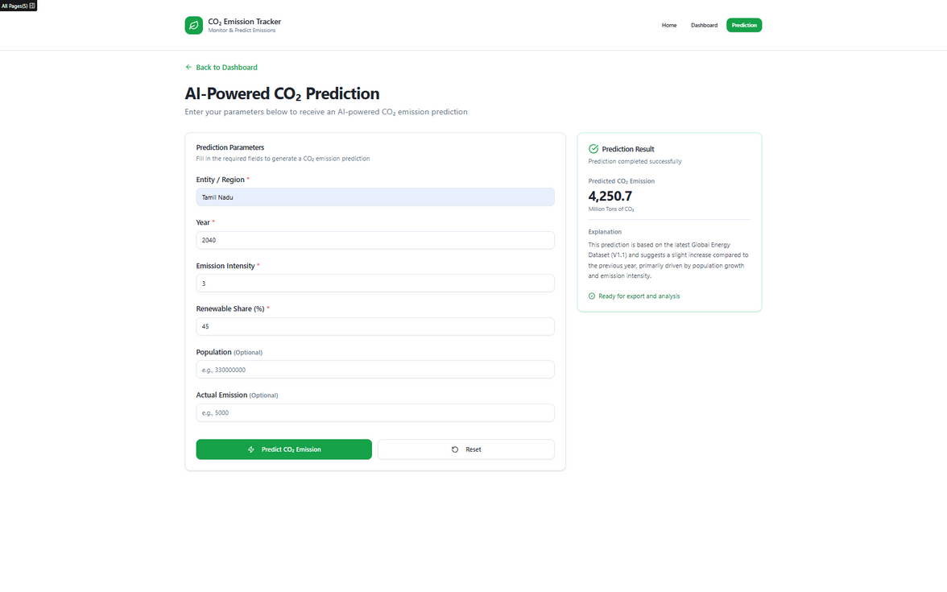
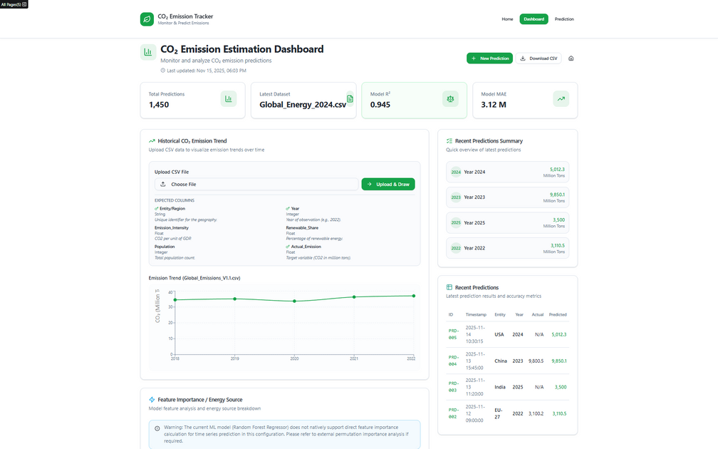
Screenshot of Output:
Prediction
Dashboard
Home

Slide 8
Conclusion:
In conclusion, this project successfully delivers a practical and efficient system for estimating CO₂ emissions using machine learning. By automating the prediction process, the application overcomes the limitations of traditional manual methods and provides users with a faster, more accurate, and more accessible way to analyze their environmental impact. The integration of a Linear Regression model with a Flask-based web interface ensures smooth data processing, instant predictions, and a user-friendly experience suitable for students, researchers, and industry professionals alike.
The system not only helps users understand the relationship between energy consumption and emissions but also empowers them to make informed decisions toward reducing their carbon footprint. With its clean dashboard, simple workflow, and reliable outputs, the project contributes meaningfully to the growing need for digital tools in sustainability and environmental monitoring.
Overall, this project demonstrates how technology and data-driven approaches can be applied to address real-world environmental challenges. It sets the foundation for future improvements, such as adding more advanced models, expanding the dataset, or integrating live monitoring features, further enhancing the accuracy and impact of CO₂ emission estimation systems.

